Slide 1
EEE310 Project proposal
Submitted by
1706091 - Monir Hossain Afif
1706092 – Tasnim Nishat Islam
1706093 – Anika Tabassum Zeba
170694 – Sajib Bain

Slide 2
Covert communication using RGB steganography transmitted via FDM

Slide 3
Covert communication using RGB steganography transmitted via Frequency Division Multiplexing Steganography is the technique of hiding secret data within an ordinary, non-secret, file or message in order to avoid detection; the secret data is then extracted at its destination. The use of steganography can be combined with encryption as an extra step for hiding or protecting data.
Take RGB value of each pixel
Encoding RGB values with hidden message
Transmission
(Frequency Modulation)
Decoding at receiver end
Get the RGB values of each pixel
Encode each value to 1 byte binary(3*1 = 3 byte)
Replace the LSB values with hidden information
Get the final value and use as a level encoder
Generate an analog signal

Slide 4
Replacing LSB with hidden message
Encoding to 1 byte value
(0, 255, 0)
R- 0000000
G -1111111
B - 0000000
R- 0000001
G -1111110
B - 0000001
RGB value
Transmission
Use each of the values as analog signal

Slide 5
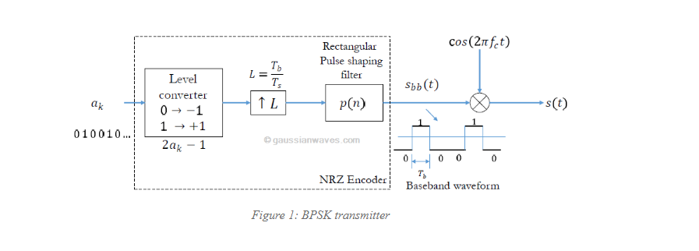
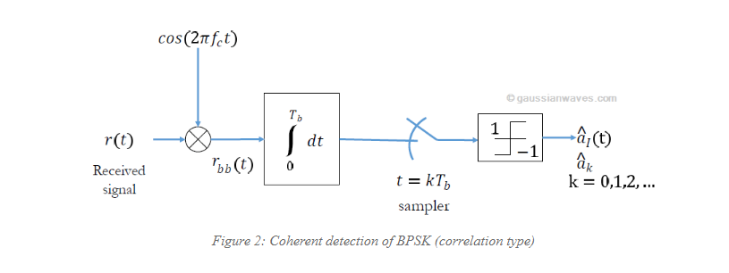
Modulation: BPSK: Binary Phase Shift Keying
Decoding: Inverse process as Encoding

Slide 6
Transmission: Frequency Division Multiplexing
R, G, B Matrix signals are after BPSK transmitter Modulation
R Matrix Signal
Carrier(fc = 100MHz)
Product Detector 1
R Matrix Signal
G Matrix Signal
Summer
Product Detector 2
G Matrix Signal
Carrier 2
Fc = 20MHz
B Matrix Signal
Carrier 3
Fc = 50 MHz
Product Detector 3
B Matrix Signal
Decoding
Band pass Filter
Bpsk receiver

